Slide 1
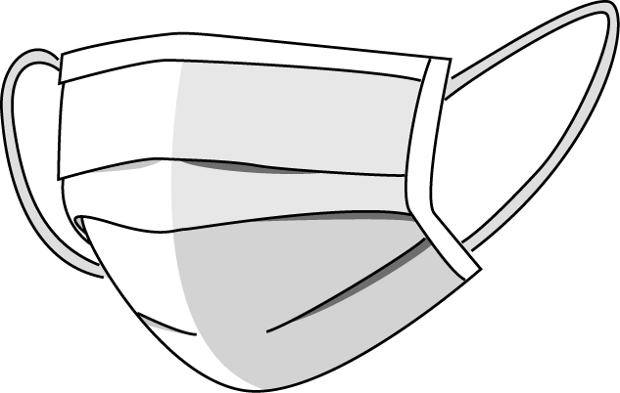
CNN for Identifying Proper Mask Wearing
Shaan Verma

Slide 2
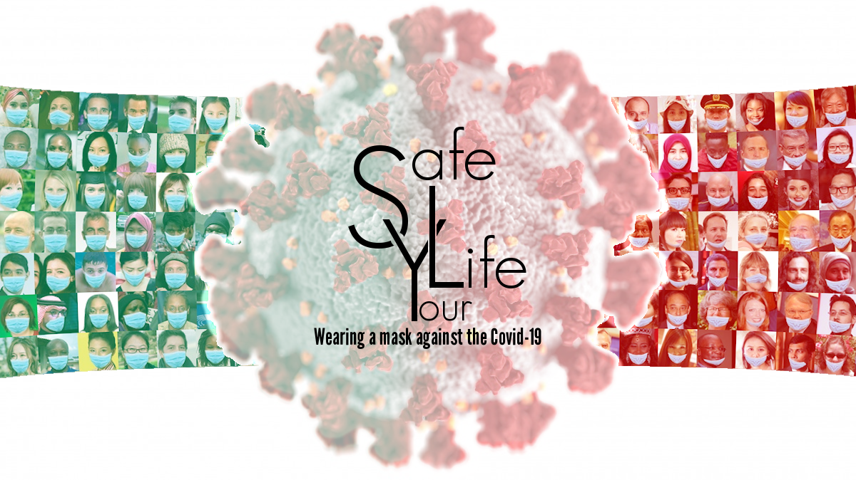
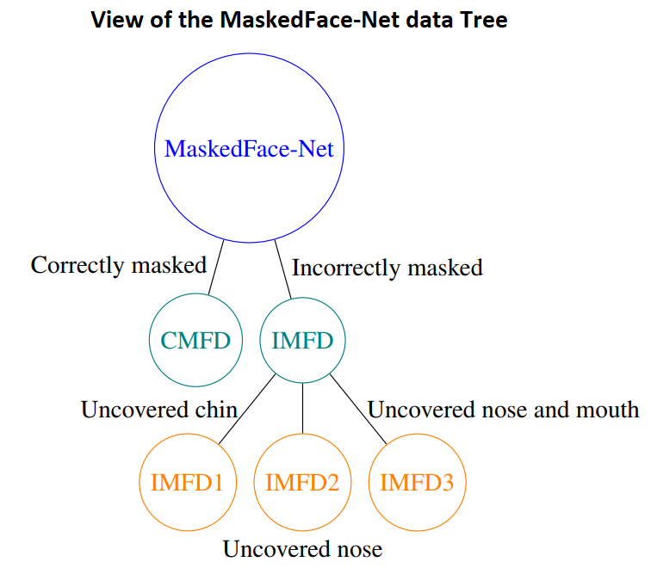
Project Objective
Implement a CNN to classify whether someone is wearing a mask properly using the MaskedFace-Net image set
Notes:
Our project objective was to implement a CNN to classify whether someone is wearing a mask properly using the MaskedFace-Net image set.
The MaskedFace-Net dataset has two main categories: correctly masked or incorrectly masked, and under incorrectly masked images there are 3 subcategories: uncovered chin, uncovered nose, and uncovered nose and mouth.
This dataset was created because the wearing of face masks appears as a solution for limiting the spread of COVID-19, and so efficient recognition systems are expected for checking that peoples faces are masked in regulated areas. (which is what we are doing here!)

Slide 3


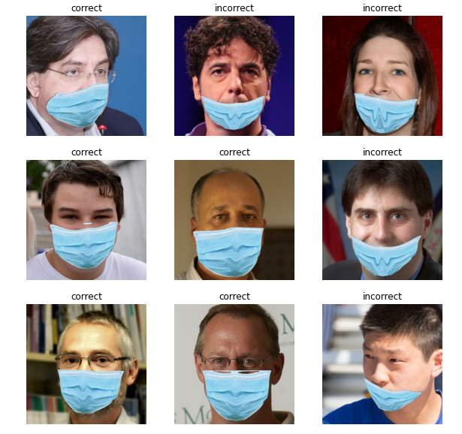
Steps
Create a subset from the original data set
Properly worn mask
Mask worn below the nose
Downsize images to 200 x 200px
Train CNN on image sets ()
Test performance using a new set
Notes:
Given that the MaskedFace-Net image set contains thousands of high resolution images, we started by creating a subset from the original dataset. This was mostly for practical reasons, we didn’t have enough space to personally store all the images that were available and we also initially thought that it might be better to have a subset as it may allow our network to run faster. We wouldn’t need to wait several hours or days for the dataset to be trained.
For our subset, we chose to work with only one of the incorrectly masked subcategories: the uncovered nose images for simplicity (so that its a binary classification), and because most of the images available from the MaskedFace-Net dataset were the uncovered nose images(80% are uncovered nose).
After selecting our image set, we then downsized the images from 1024x1024px to 200x200px. Again, this was a choice we made to reduce the time and cost of the network running. After downsizing, we implemented the CNN and trained it on 800 images of correctly worn mask images and 800 incorrectly worn mask images, and we tested its performance using a new set.

Slide 4
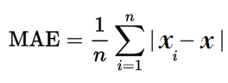
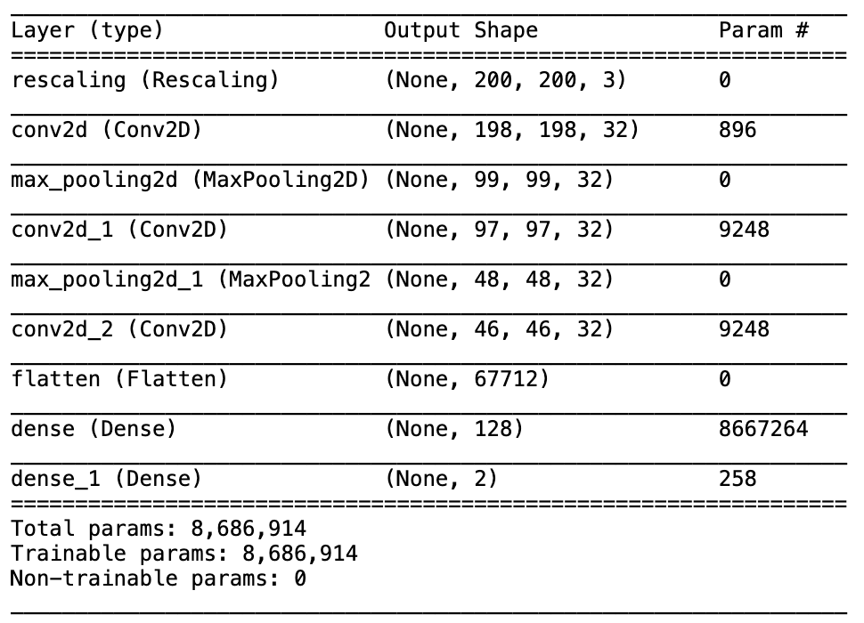
First Model
Based on tensorflow tutorial for CNN:
● 5 layers (3 convolutional, 2 fully-connected)
● 32 filters per convolutional layer, kernel size 3
● Optimizer: adam (tensorflow)
● Loss function: MeanAbsoluteError
Notes:
The architecture for the first model was based off of a tensorflow website tutorial on how to build CNN’s. It’s a standard CNN that’s not optimized or tuned.
A little bit about the architecture of the model:
5 layers, 3 convolutional layers and 2 fully-connected layers.
Convolutional layers: 32 filters, kernel size 3, uses rectified linear activation function. This function has become the default activation function for many types of neural networks. it is easier to train and often achieves better performance.
Fully-connected layers: 128 filters
Optimizer: Adam
This seems to be a go-to optimizer for CNN’s, it is a replacement optimization algorithm for stochastic gradient descent. Apparently is can handle sparse gradients on noisy problems and is easy to configure and the default configuration parameters do well on most problems.
Loss function: MeanAbsoluteError (tensorflow)
MAE is one of the most simple widespread measures of loss in statistics. Wanted to keep the model simple and consistent with standards.
MORE INFO:
ADAM: Adam is a replacement optimization algorithm for stochastic gradient descent for training deep learning models. Adam combines the best properties of the AdaGrad and RMSProp algorithms to provide an optimization algorithm that can handle sparse gradients on noisy problems. Adam is relatively easy to configure where the default configuration parameters do well on most problems. Learning rate is 0.001.
DENSELY CONNECTED VS. CONVOLUTIONAL LAYERS: A densely connected layer provides learning features from all the combinations of the features of the previous layer, whereas a convolutional layer relies on consistent features with a small repetitive field.
CONVULTIONAL LAYER - RELU: The rectified linear activation function or ReLU for short is a piecewise linear function that will output the input directly if it is positive, otherwise, it will output zero.
More filters is more features…more precision… more details…. kernel is size of features…

Slide 5
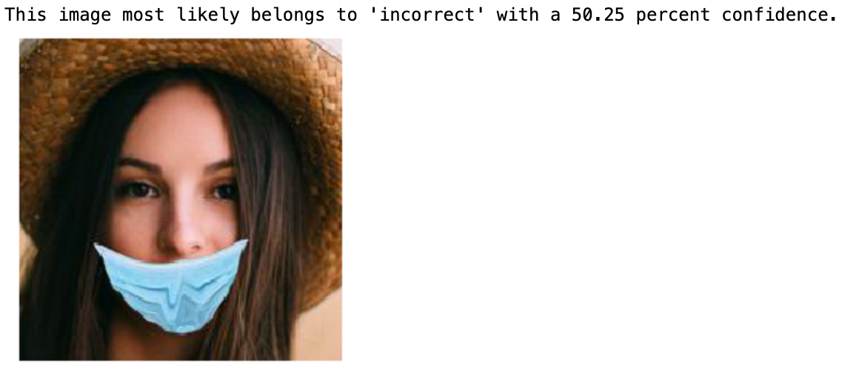
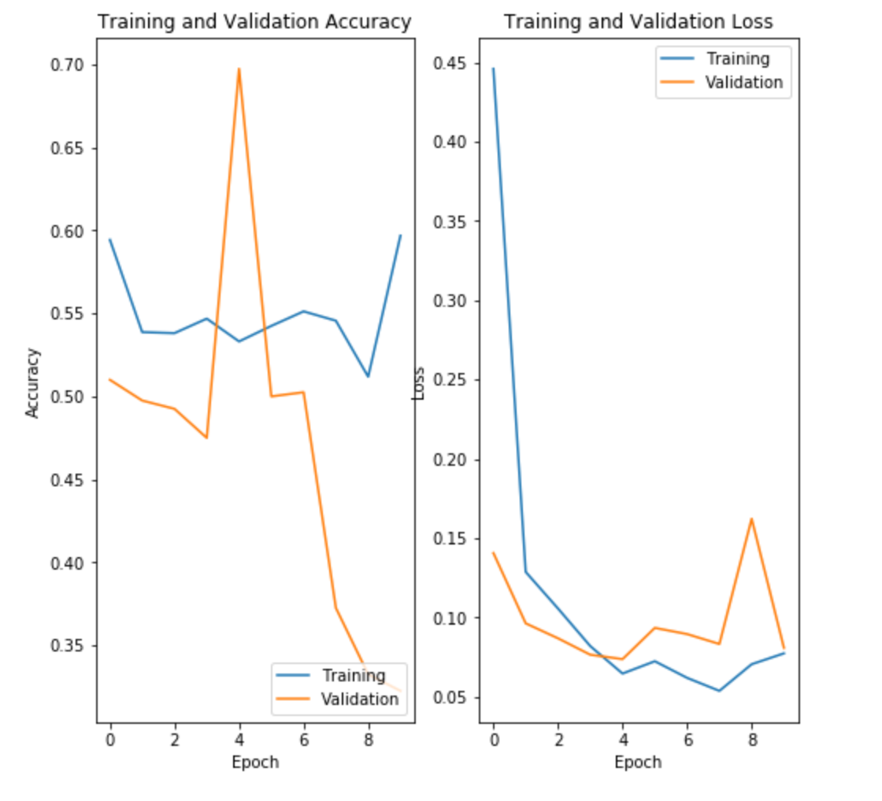
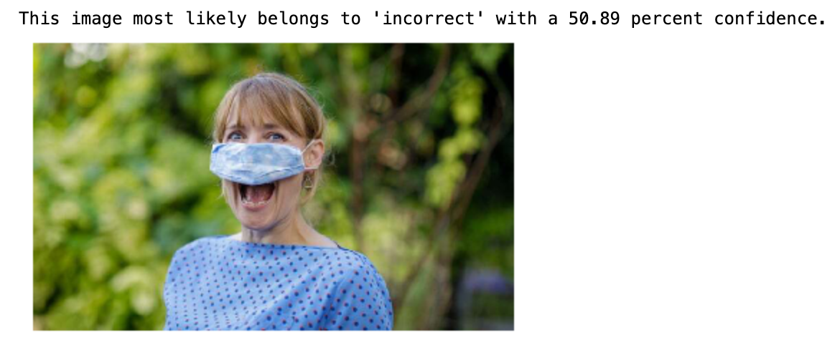
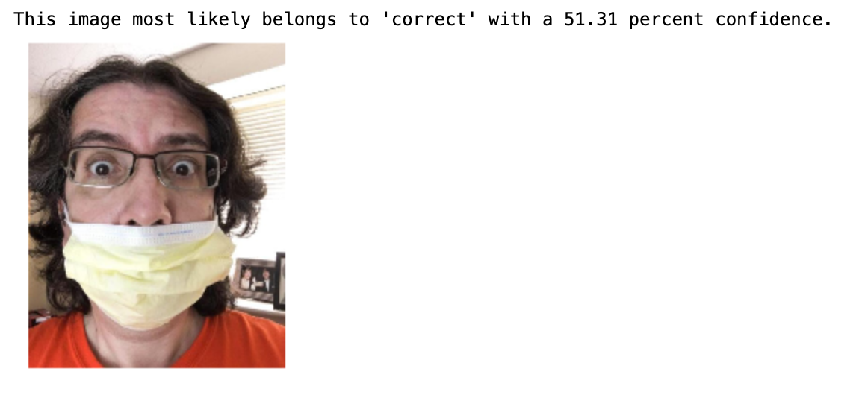
Results: First Model
Notes:
Our model shows signs of what we think are overfitting - having higher error in the testing set than in the training set. The testing/training sets have strange patterns of behaviour as well, they do not show the expected learning curve over time. Rather for training it starts and ends in the same place and shows worse performance in the middle. We also initially ran the model using 10 epochs, we had thought the more epochs the better the accuracy, which was not the case.
MORE INFO:
Overfitting: Overfitting or high variance in machine learning models occurs when the accuracy of your training dataset, the dataset used to “teach” the model, is greater than your testing accuracy. In terms of ‘loss’, overfitting reveals itself when your model has a low error in the training set and a higher error in the testing set. You can identify this visually by plotting your loss and accuracy metrics and seeing where the performance metrics converge for both datasets.

Slide 6
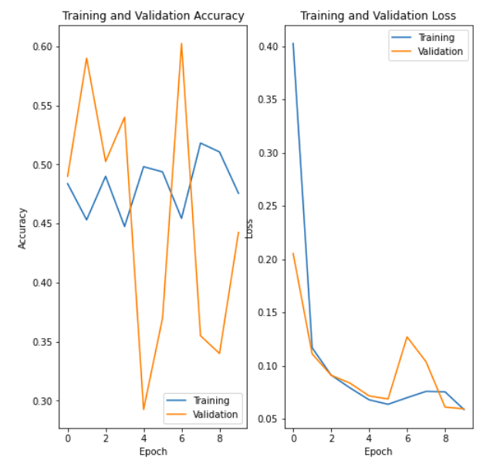
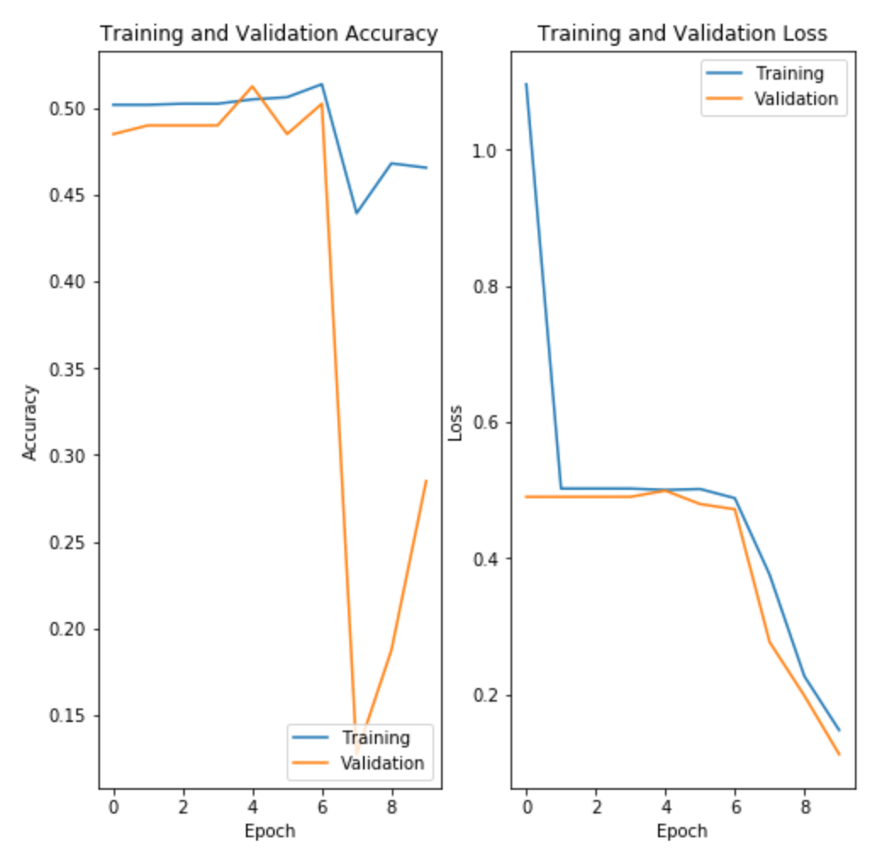
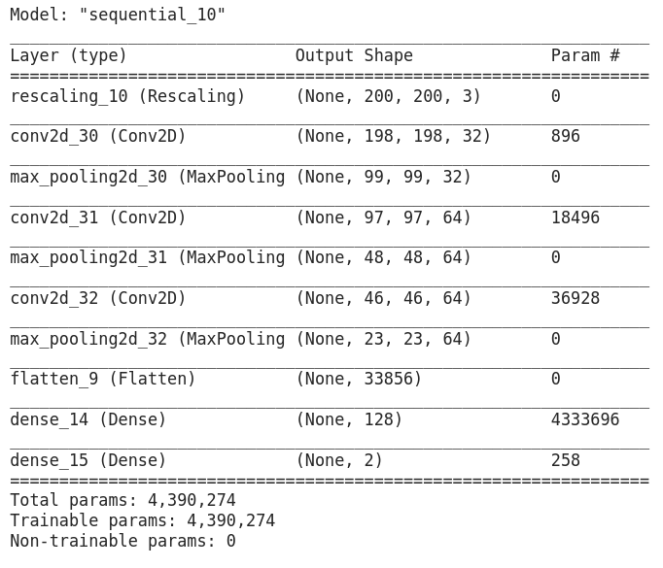
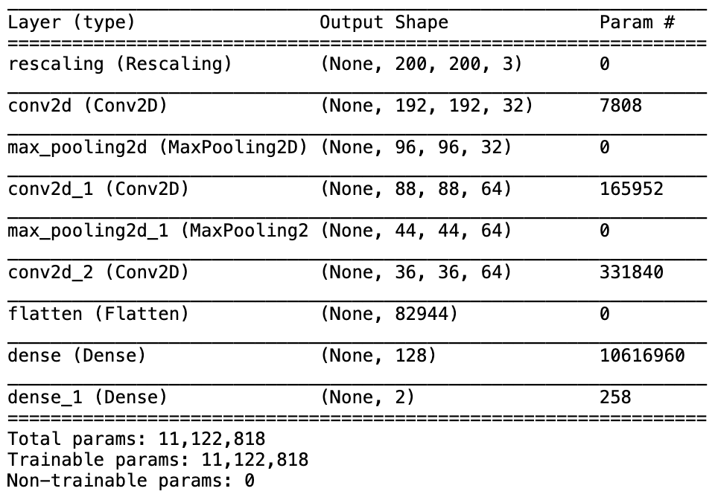
Model Experimentation
Model 2
Model 3
Notes:
After getting our model to work, we started trying to make it perform better by changing some parameters and comparing the performances. We manipulated and tested several different filter and kernel sizes. We know that smaller filter collect more fine grained information whereas bigger filters represent more global, high-level and representative information. We weren’t sure which would actually be best for our network considering that the mask does take up a large portion of the face… then again… facial features are probably more fine grained information. So we decided to manipulate the filters to see what would happen.
For the second model we increased the 2nd and 3rd convolutions to 64 filters, and for the third model we increased the kernel size to 9. These were still using the same optimize and loss functions.
We can still see that there is overfitting happening with model 2… and although the loss graph for model 3 doesn’t look like overfitting, the accuracy is still questionable.
After fine tuning some of these parameters… we realized that this may not actually be the best approach in terms of getting a good model. We were starting to think our model was perhaps too complicated for the problem we were trying to solve. So instead for our final model, we scaled back on some of the parameters to make it more simple...

Slide 7
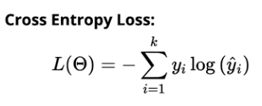
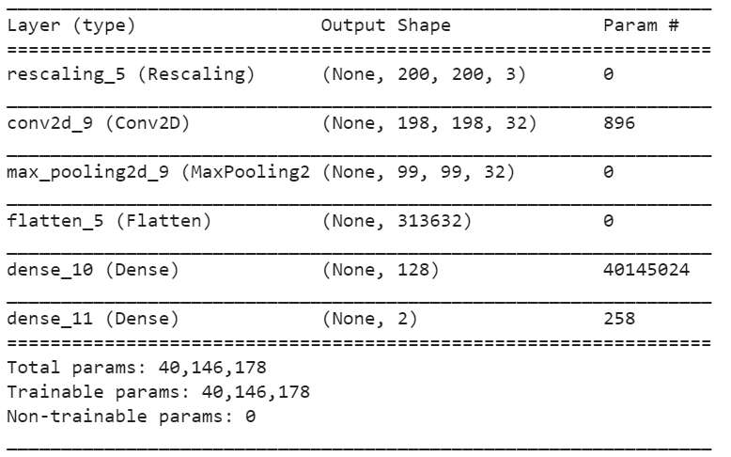
Final Model
Simplified layers to avoid overfitting and changed loss function
● 3 layers (1 convolutional, 2 fully-connected)
● 32 filters per convolutional layer, kernel size 3
● Optimizer: adam (tensorflow)
● Loss function: SparseCategoricalCrossentropy
Notes:
In our final model, we simplified layers to avoid overfitting. We found that our model might be too complex for the problem we were trying to solve (binary classification). We also changed the loss function from the mean absolute error to sparse categorical cross-entropy. The problem with mean absolute error is that it does not punish misclassifications enough.
The Cross-entropy loss, or log loss, measures the performance of a classification model whose output is a probability value between 0 and 1. Cross-entropy loss increases as the predicted probability diverges from the actual label. Cross-entropy loss is a measure of the difference between two probability distributions for a given random variable or set of events. Lower probability events have more information, higher probability events have less information. Used as a standard loss function. For classification if you get it wrong, it punishes it more.

Slide 8
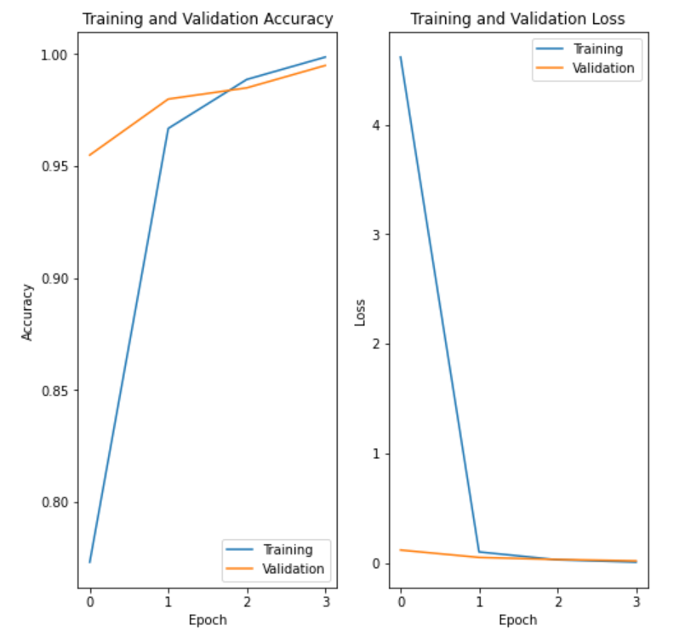
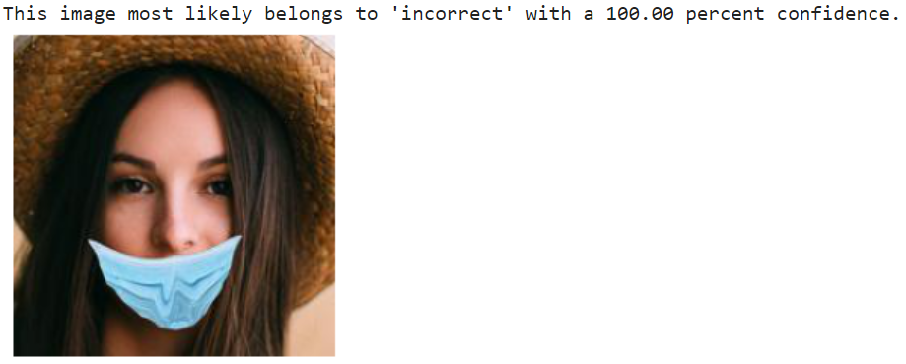
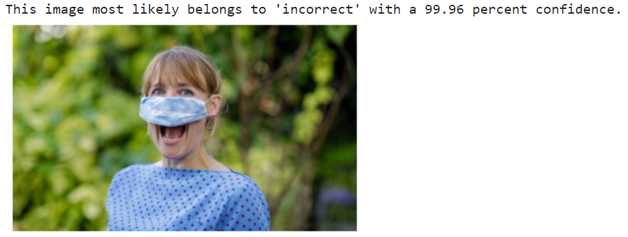
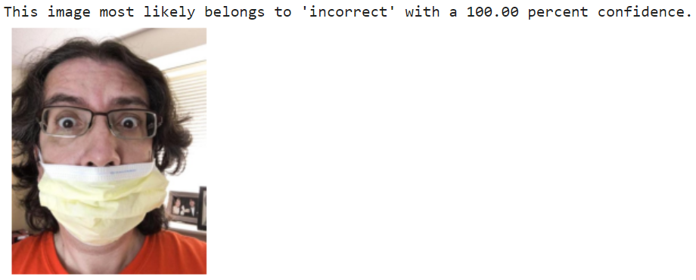
Results: Final Model
Notes:
We still might be having some overfitting, you can see that the validation line is crossing about the training line for the loss function. We think that increasing our training data would probably be beneficial and could help with overfitting. We are only showing the network 800 examples of correct vs. incorrect masks which may not be enough. You also might notice that we reduced our epochs. Originally we thought the more epochs the better the accuracy, which was not the case… we looked at several other models and those that were using around 10 epochs had MANY more images than we were using.

Slide 9
Questions?

Slide 10
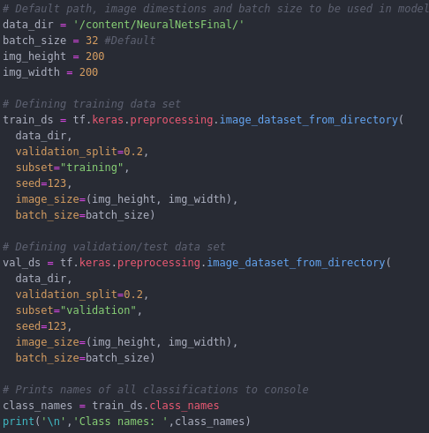
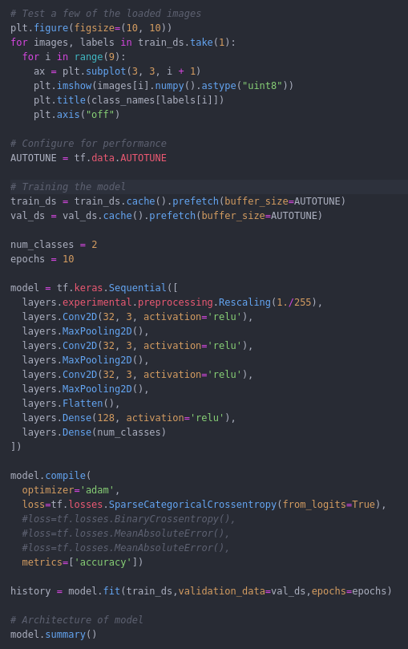
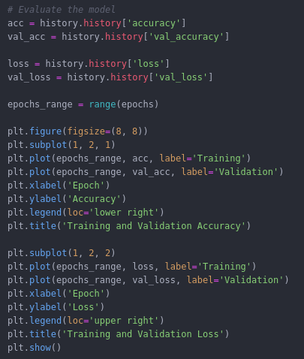
CNN Code

Slide 11
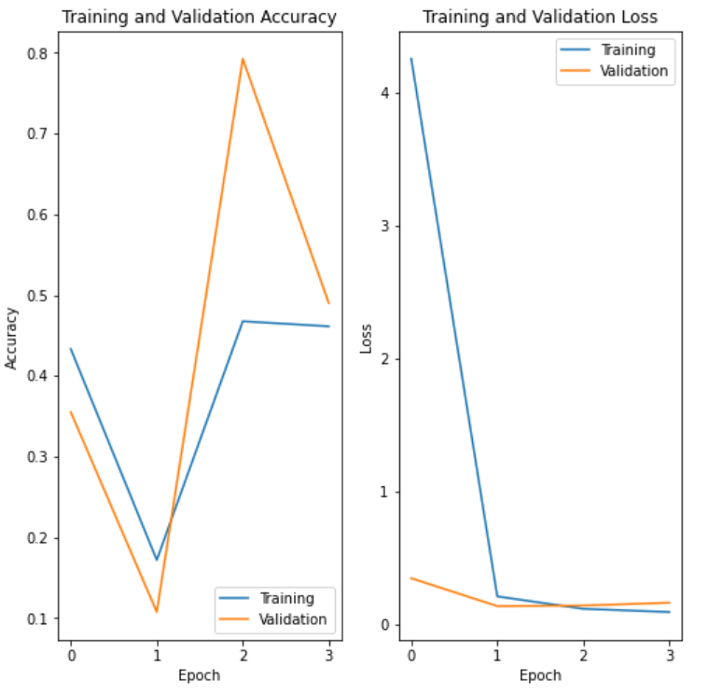
Final model but with mean loss function instead of entropy
Notes:
This is the final model with the mean loss function instead of entropy function. There is some weirdness going on with the training.

Slide 12
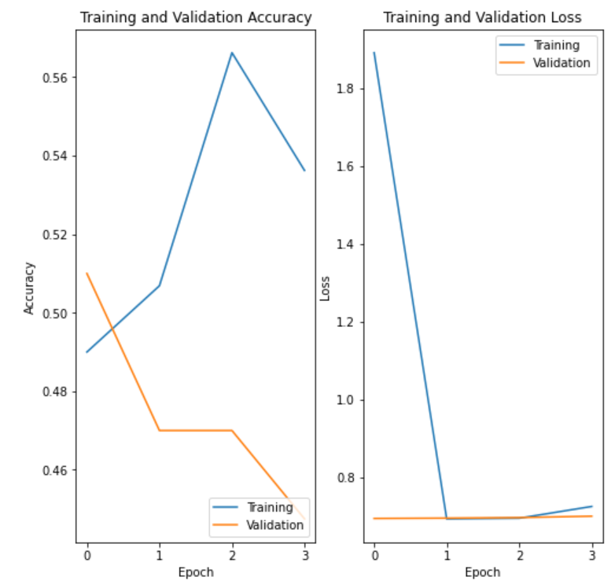
Final model but with entropy loss function but kernel size 9
Notes:
This is the final model with the mean loss function instead of entropy function. There is some weirdness going on with the training.

